Slide 1

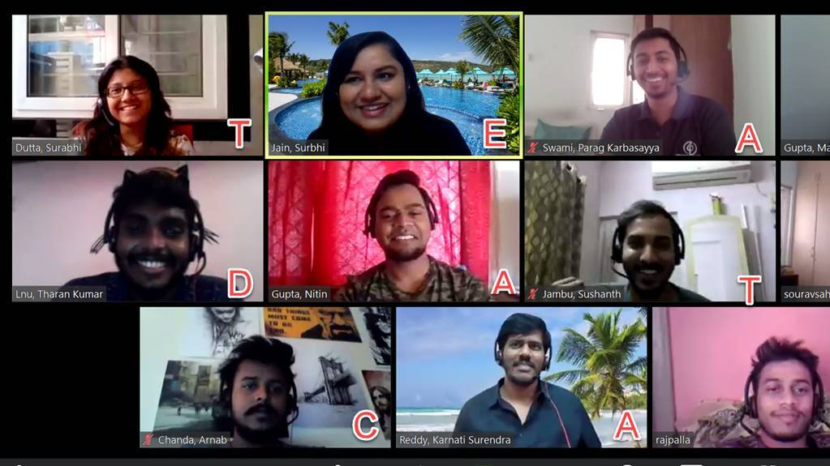



Slide 2

Final Big Team, Small Feel Competition – Impact Story
Every cloud has a silver lining – with this pandemic we were all worried about projects being shut down, but little did we know that we will get a project even in this situation! Taught us how no matter what, things eventually do workout and Being positive in every aspect is what matters (not Covid-19 positive though) :)
With the Big Team Small Feel contests, we got an opportunity to bond more as a team and got to know about their hidden talents (trust me, there are many!) and we really hit it off.
Lesson no. 3 – Anything is possible, you just gotta believe. Going from 30 invoices/day to 100, we remember how doing 100 invoices per day seemed like an impossible task in the first few weeks but hey, here we are! 😉
Learning a new tool – DataCap was definitely a takeway – can proudly add that to our resumes :P
The level of support and help that we received from the team members in these 7 weeks is highly appreciable and we surely collaborated well and are proud to be a part of this amazing team.
This was a first project for many of us and we never imagined interviewing an MD and having a fun conversation with him.
We are taking away so many memorable (and fun) stories and learnings with us which will bring smile on our face every time we will think of DataCap team and will also help us grow in our journey at Deloitte.
As a lead Nitin was wonderful, he supported all of us individually. He guided us throughout so that we could process more and more invoices with accuracy, and he played a vital role in bringing out the best in us

